Slide 1
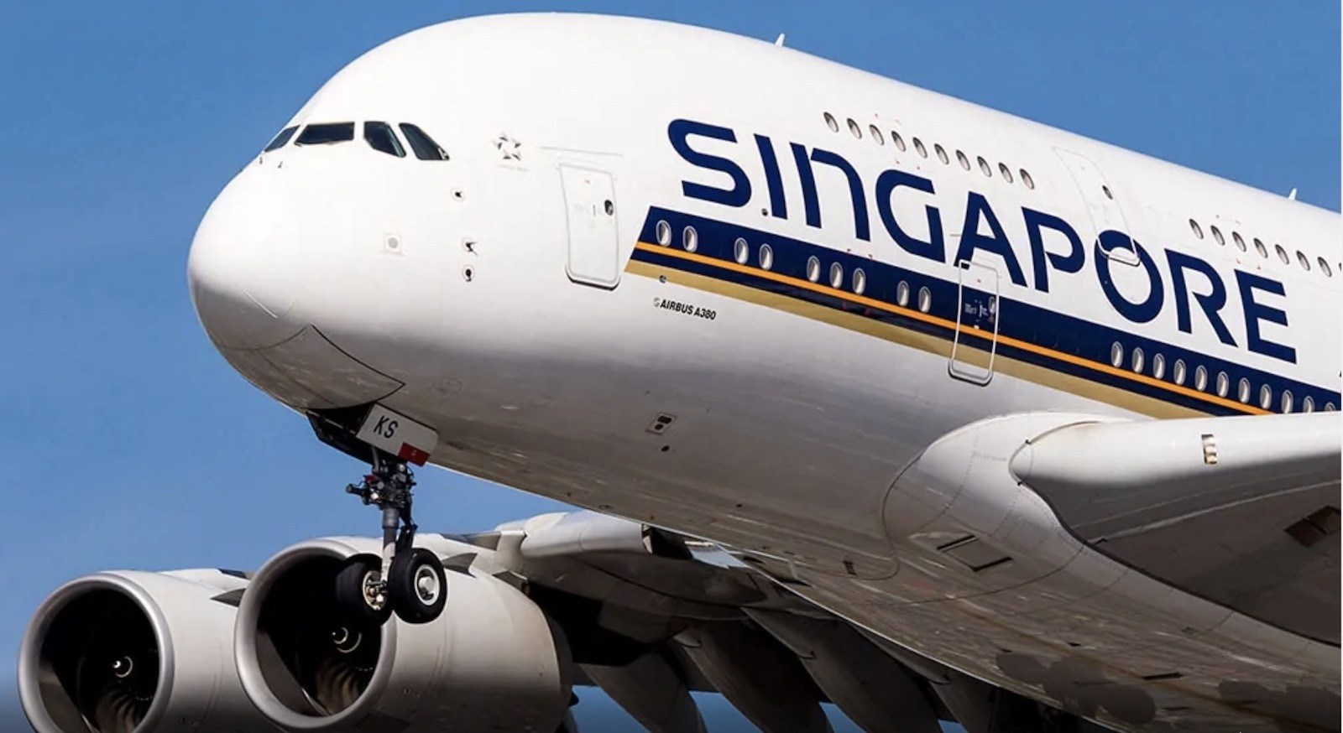
KrisMate
Team: Aviators
APP CHALLENGE 2020
PITCH-DECK

Slide 2
KrisMate

Slide 3
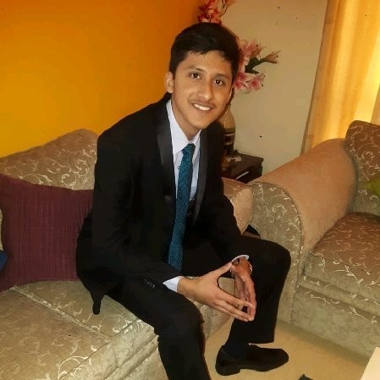


TEAM: AVIATORS
Raghav Mantri
Anshul Gupta
Pranay Mathur
NTU Computer Engineering Undergraduate
NTU Mechanical Engineering Undergraduate
NTU Electrical Engineering Undergraduate

Slide 4


Problem / Pain Points
Manual booking system at lounges
Time-consuming
Inefficient
Crowded facilities due to lack of monitoring
Unsafe
Bad customer experience
Lack of digitalized assistance platforms
Results into extra expenditure

Slide 5

Our Idea
KrisMate provides premium members with an app-based solution to monitor and book amenities at various KrisFlyer lounges worldwide in a fast, easy and convenient way.
KEY FEATURES:
Contactless & wireless booking of amenities via QR code at lounges.
24X7 Chatbot for assistance.
Advanced Meal-planning.
Checking amenities from any location.
Staff-less monitoring of amenities.

Slide 6
Technology
Advanced booking into 9 amenities.
QR scanning to check-in into amenities at the lounges.
FAQs powered by static data to clarify customer queries round the clock.

Slide 7

Tech Stack used
Flutter, a cross-platform app development framework by Google has been used to develop the app

Slide 8
Advance Booking
Select a facility to advance book
Check-in using QR code at the lounge
Login using credentials
If the amenity is already fully booked at that time
Get added to the waitlist

Slide 9
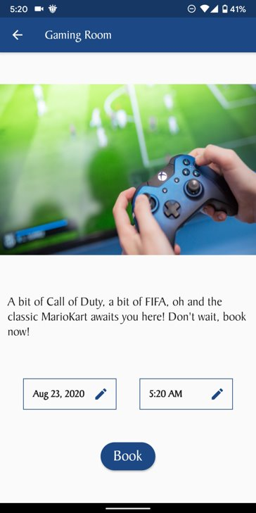
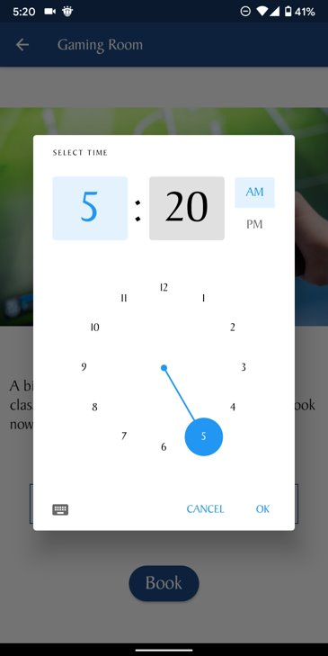
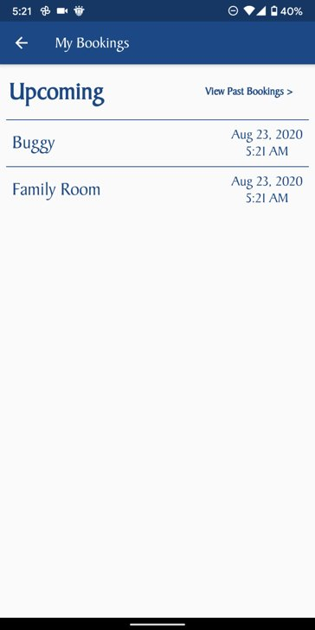

Slide 10
Check-in at the lounge
Scan QR code at the amenity
Check-in and enjoy!
Login using credentials
If the amenity is already at capacity
Get added to the waitlist

Slide 11
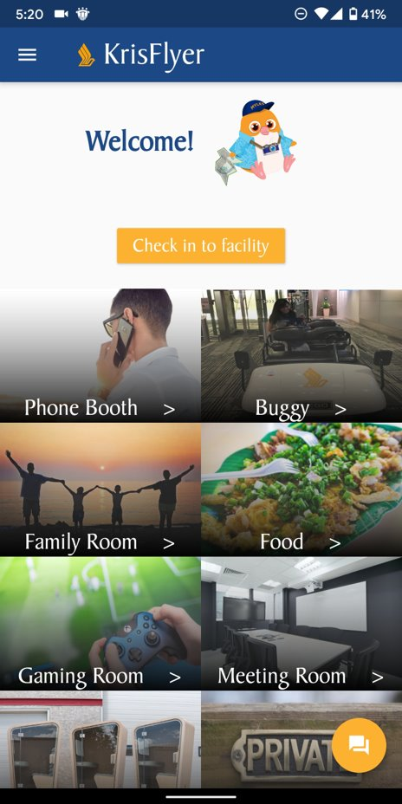
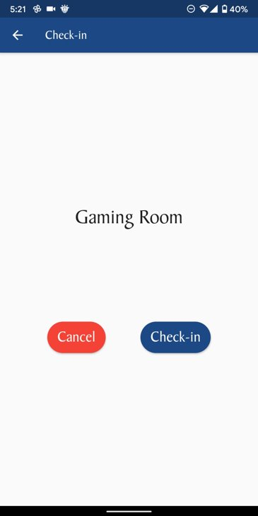
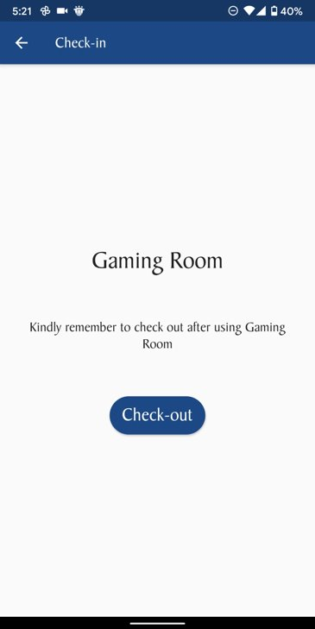
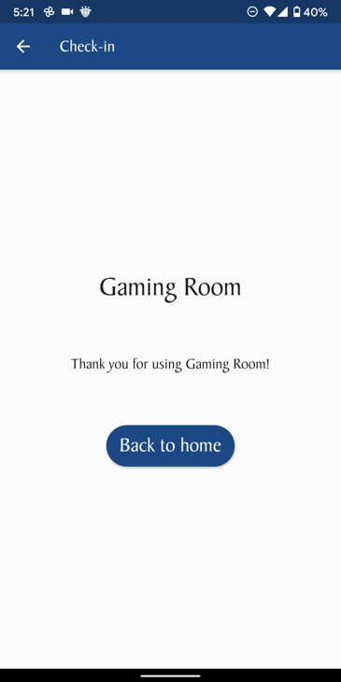

Slide 12
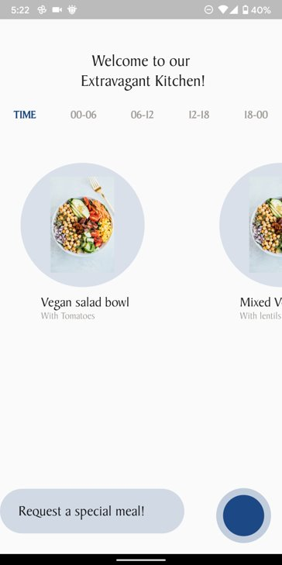
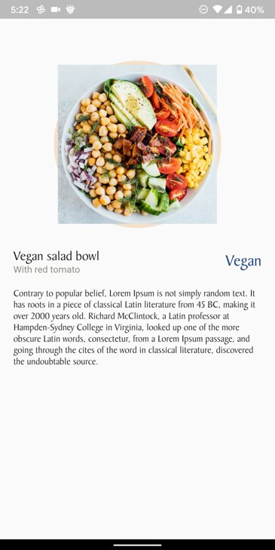
SilverKris Lounge Menu

Slide 13
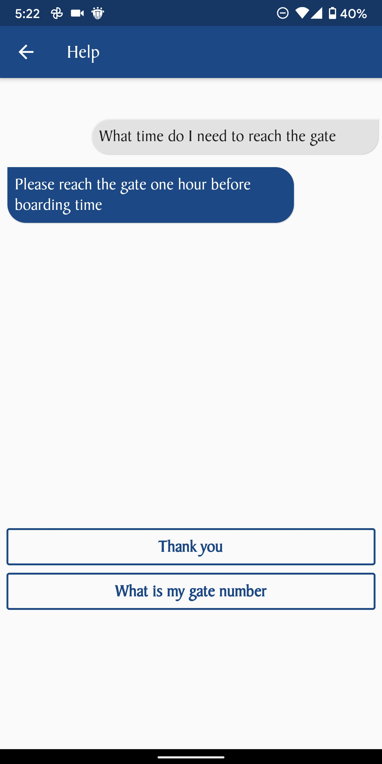
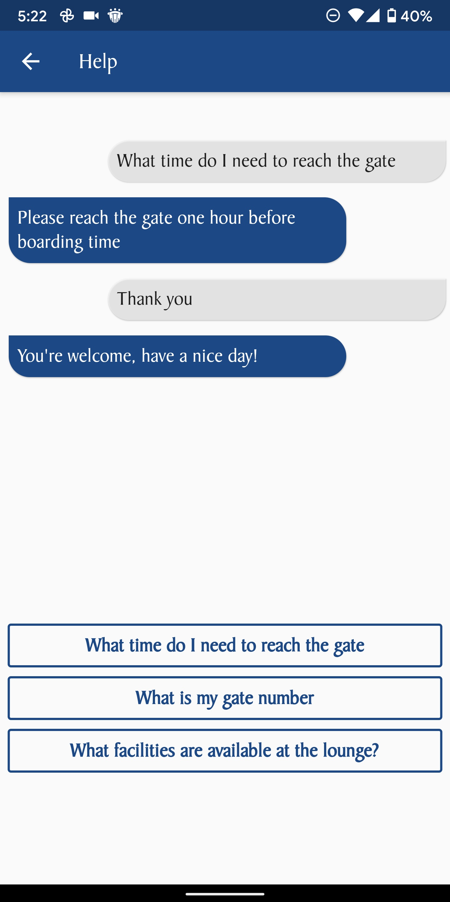
KrisMate’s FAQ ChatBot

Slide 14
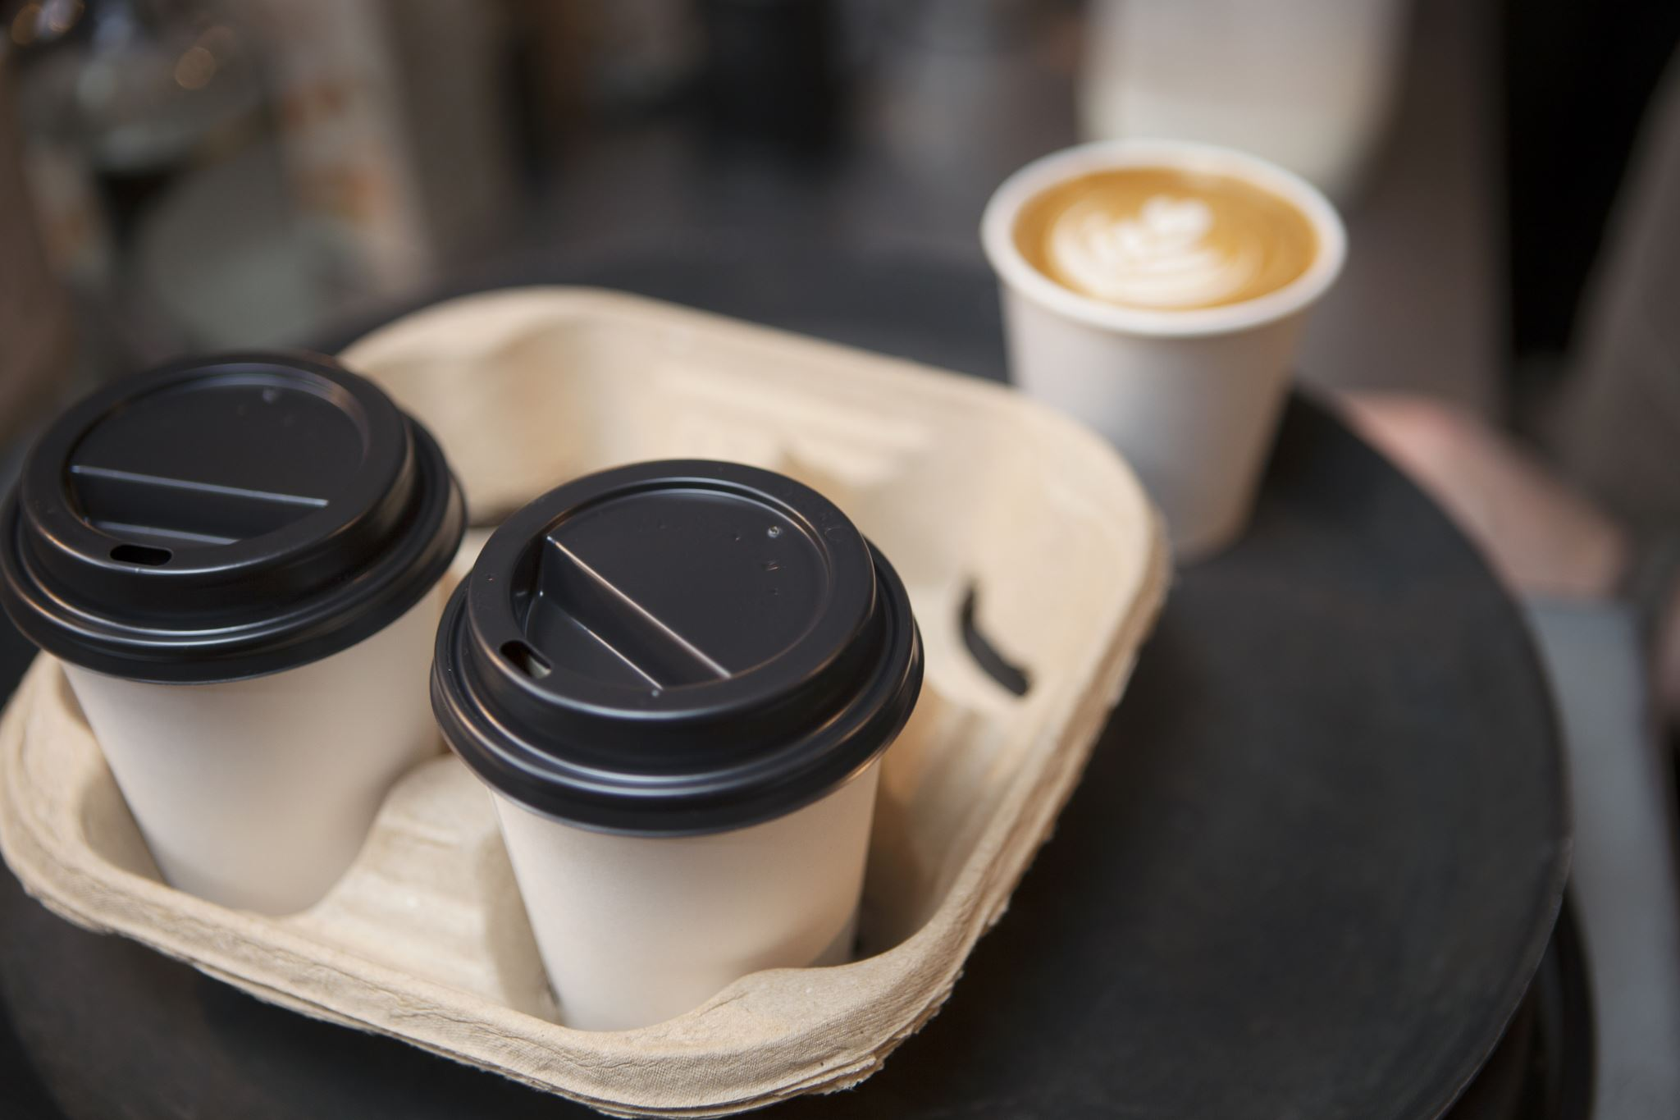
What sets us apart
A One Tap solution for all amenities provided at KrisFlyer Lounges worldwide
Useful in and out of the lounge
Advanced booking of facilities
Contactless check-in of lounge facilities

Slide 15

QR scanning to check in!
Taking inspiration from SafeEntry
Wireless means of check-in
Direct registry in booking history
Very quick, no human intervention
Negligible costs and highly feasible!

Slide 16
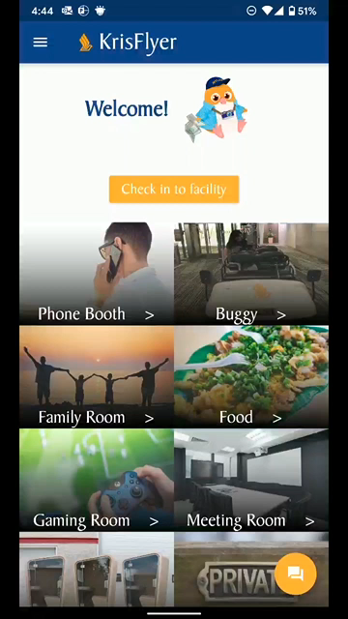
Demo
Here’s a walkthrough video!

Slide 17



Business Value
Reduced staff needs.
Check-in bottleneck eradication.
Greater staff utilization.
Direct Financials
Operational
Consumer/Employee Satisfaction
Lesser time to check-in
Lesser logistics cost
Increased efficiency
Higher customer satisfaction
Higher employee satisfaction

Slide 18
Project Plan & Next Steps
Share with us your roadmap
Flight itinerary integration to provide notifications for advanced booking
App launch on App markets on Android and iOS
Preparation of APIs for real-time data regarding lounge facility occupancy and implementation in the app
Chatbot powered by Natural Language processing integrated with ready FAQ chat section in the current app
List of Global lounges with varying facilities and their booking directly linked into the app using APIs yet to be developed by SIA

Slide 19
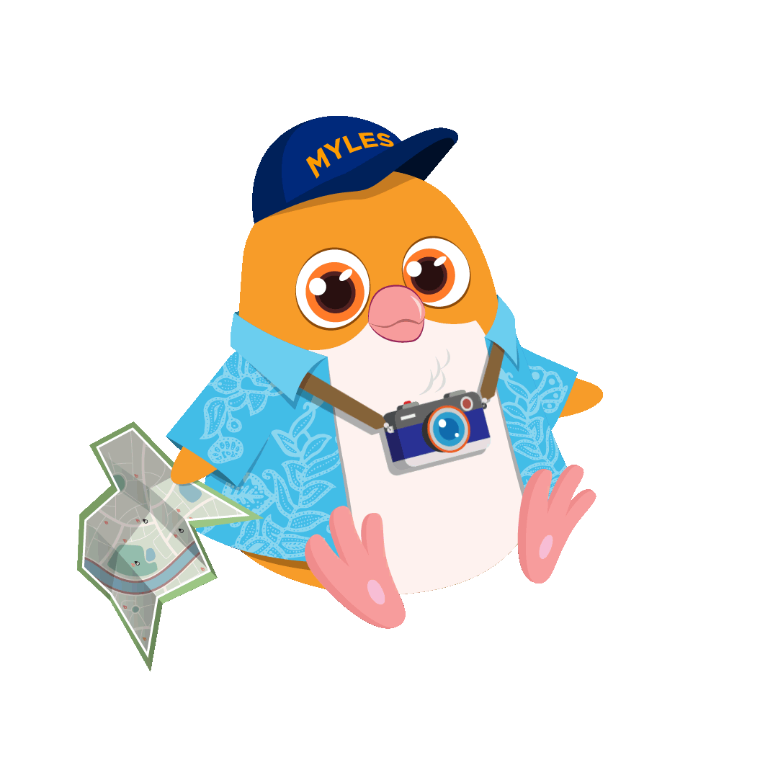
Thank you!

Slide 20
Our code
https://drive.google.com/file/d/14BKLkcQVehTZvC59XSquxJH8O0VHK02Q/view?usp=sharing

